Slide 1


Slide 2
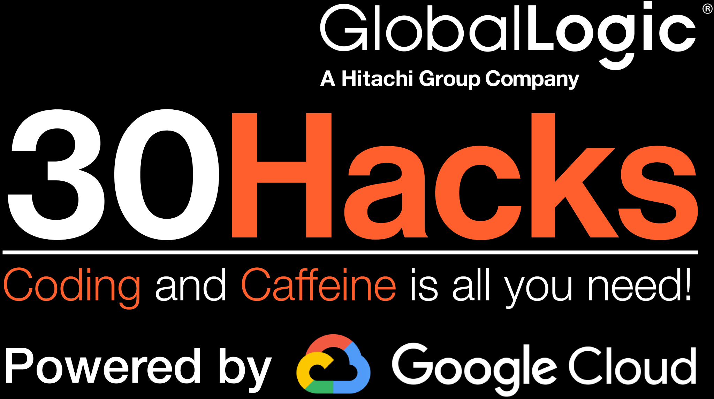
Code in Minutes: The Future of Software Development with AI Agents
Team Name : Autonomers
Team members: Amogh Prabhu
Chankilam NagaPranav
Ravi Yadav
Thota Bhargav
Hack Wizard - Prashant Kumar
bhu

Slide 3

Our IDEA?
Problem Statement -
“No Code Platforms” are a myth, at the end developers have to writes lots of codes in any NO CODE platforms.
Currently no tool generates 100% working Application is a single click by just looking at the user prompt.
Solution -
GenX solution on AI Agents to generate any PYTHON app on a single click.
A Multi-Agent AI Platform that Autonomously Creates End-to-End Python Applications from User Prompt.
Approach -
Multi-Agent System: A collection of AI agents, each specialized in different tasks such as code generation, debugging,Compiling, Unit testing (In-progress) and GUI design.
Automation: The AI system takes a user prompt (e.g., "Build a simple calculator using Python and a GUI") and autonomously develops the application.

Slide 4
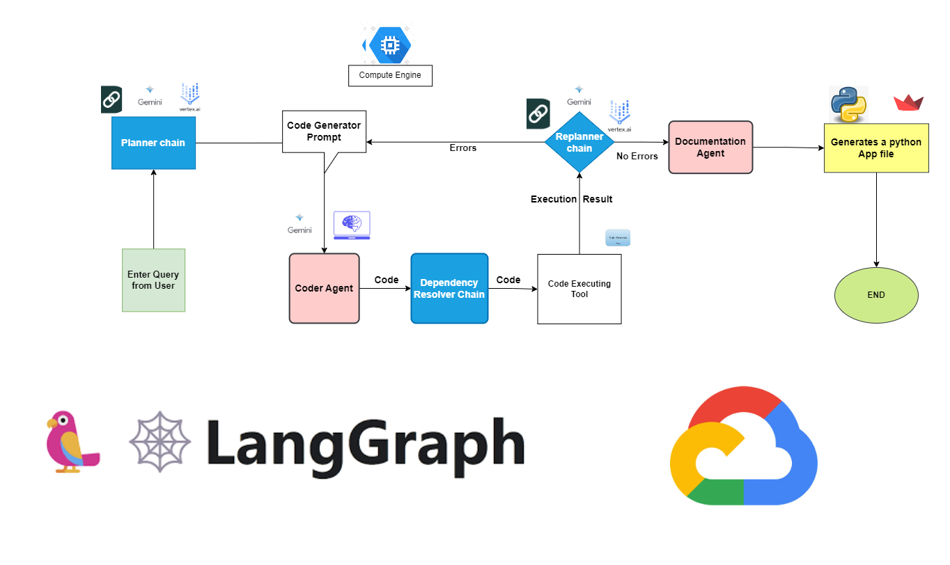
InstaDev: Solution Design

Slide 5







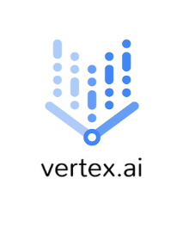
InstaDev: Tech Stack
Langchain
Python
Python
Streamlit
GCP Cloud
Gemini
Compute Engine
Vertex Ai

Slide 6
Our Distinct Path & Goals
How this is Unique
Autonomous Development
[ FROM Business case upload TO Prod Ready Application download ]
Multi-Agent Collaboration
[ Agents to code generate, debugging, compiling, testing & deployment ]
Fully Functioning software in a single click
Future Plan
Unit Testing
Currently In-Progress
Language Independent
Currently output is on Python
Implementing with task specific LLMs
Currently on Gemini, can be task based

Slide 7
Use cases for DEMO
Generate a application which can take Resume and job description as input to find best match profiles.
Generate a Login page for school management system
Generate a attendance app for an employee or school or for any general attendance purpose
Generate a tic tac toe game,
Generate a snake ladder game,
Generate a sudoku game and many more simple gui game
Generate a stopwatch and Calculator application
Generating a Music Player to play music
Generate a Background Remover for images
Generate an Image editor application
Generate a Code Editor like notepad

Slide 8
Q&A
Notes:
I hope that this was a helpful overview, and I’m glad to answer any questions about GlobalLogic, or dig deeper into any of these areas.
Thank you for your time.

Slide 9
THANKS

